Slide 1

ROOM & KEY CARD
Tea and coffee making facilities are replenished daily
1.5L bottle of water per room on daily basis
SAFE
We kindly ask that all valuables are placed in the safe inside the wardrobe, as the hotel cannot accept any responsibility for the loss of these. Please leave the safe open on departure day.
TELEPHONE
Please contact reception by dialling 0. Available 24/7.
To make national or international calls, please contact our reception (2 Euro/Minute). To call another room, please dial the respective room number.
RECEPTION
Our 24 hour service will assist with all general questions, and provide relevant information such as directions, limo reservations, bedding, porter service etc.
Check-in 14:00 pm, check-out 12.00 pm. Late check-out is subject to availability and with extra charge. Please settle your room bill payment one day before check-out.
Do not pay for the services in cash, sign the check, and pay at the reception desk later. We accept EUR, USD, GBP, EGP or credit cards.
INTERNET
Please activate your Wi-Fi and choose JHG network – enter your room number, first name and your email address in the appropriate fields.
Remember to turn off data roaming to avoid network charges from your operator.
POOL & BEACH AREA
You will find pool/beach towels inside your room, change during your daily turndown service at 18:00. Outside of this time please ring reception. Please bring the towels back from the beach to the hotel.
The reservation of sunbeds is not permitted, and staff is authorised to remove items from sun loungers after extended periods of non-occupancy.
LAUNDRY & DRY CLEANING
Against extra charge. Please refer to laundry list for prices.
RESTAURANTS & BARS
Eagle Main Restaurant
Breakfast 07:00 - 10:00
Dinner 19:00 - 21:00
LateBreakfast (NineteenResturant) 10:30 – 11:30
Nineteen Restaurant ( Against charge)
Lunch 12:00-16:00
Tea Time 16:30-17:30
Ice Cream during open hours
Beach Restaurant ( Against charge)
Drinks Service 10:00-Sunset
Lunch 12:00-16:00
Bogey Bar ( Against charge)
Drinks Service till midnight
Dress Code:
Smart casual. Shorts and flip flops are not permitted.
A LA CARTE RESTAURANTS
1 complimentary dinner per stay in one of the following a la carte restaurants: Nino’s, Amaya, Makai Tukai, Sofra, Beach Restaurant, The Grill or Aqua Restaurant.
Restaurants are located within the heart of Madinat Makadi. Pervious booking is required 48 hours before at the touch screen in the lobby.
Allergies and dietary requirements – please notify Front desk or Kitchen Chef.
ENVIRONMENTAL AWARENESS
We are extremely concerned of our environment and as such make great efforts to support in all spheres wherever possible. For more information please refer to our environmental boards and TV information channel.
SERVICES
Free of Charge
Upon request 1 day in advance book via reception:
  Wake up call
  Lunch/Breakfast box
  Tennis court at Jaz Makadi Star (Floodlight 100 le/h)
GYM 08:00-20:00
Health Club 14:00-18:00
Shuttle bus service to the beach
Wheelchairs upon request and subject to availability
ATMs are located in Souk Makadi, beside La Loca and in Jaz Aquaviva hotel
Sport & Entertainment
Daytime soft activities
Daily evening entertainment in Bogey Bar.
Please refer to info boards for a full breakdown.
Extra Charge
Room service
Minibar beverages, juice, sparkling water and snacks are at extra charge. Please notice the minibar list in your room
Telephone: national & international calls
Limousine service, airport pick-up and drop-off
Shisha Corner at Jaz Makadi Saraya
Makadi Water World Aqua park 10:00-17:00 at Jaz Aqua viva
Doctor 12:00-13:00 at the clinic and Pharmacy (3rd party)
Mividaspa: spa center & beauty salon
Diving center, surf centre, water sports and camel riding
Golf course: A superb 18 hole championship golf course, a fun 9 hole par 3 course, plus excellent training facilities
for more information please contact the Golf Club.
TAKE CARE
Avoid direct sunlight especially between 11:00-15:00. Temperatures can reach 45+, which might cause burns and severe dehydration.
Drink water continuously throughout the day. Water is provided in all hotel bars. Dehydration causes upset stomach, dizziness, nausea and headaches.
Always use sunscreen with sunblock to avoid sunburns. Wear a headgear when explored to the sun.
Avoid sudden changes in temperature (from warm to cold and vice versa). Give your body a few minutes to get used to the new temperature. Sudden temperature changes can cause health issues, please do not make your air conditioning in the room colder than 25 degrees.
Please note that due to fire regulations, smoking of hookahs / shisha in the room is not allowed.
The use of third-party providers outside the hotel (e.g. shops, limousines, etc.) is at your own responsibility.

Slide 2
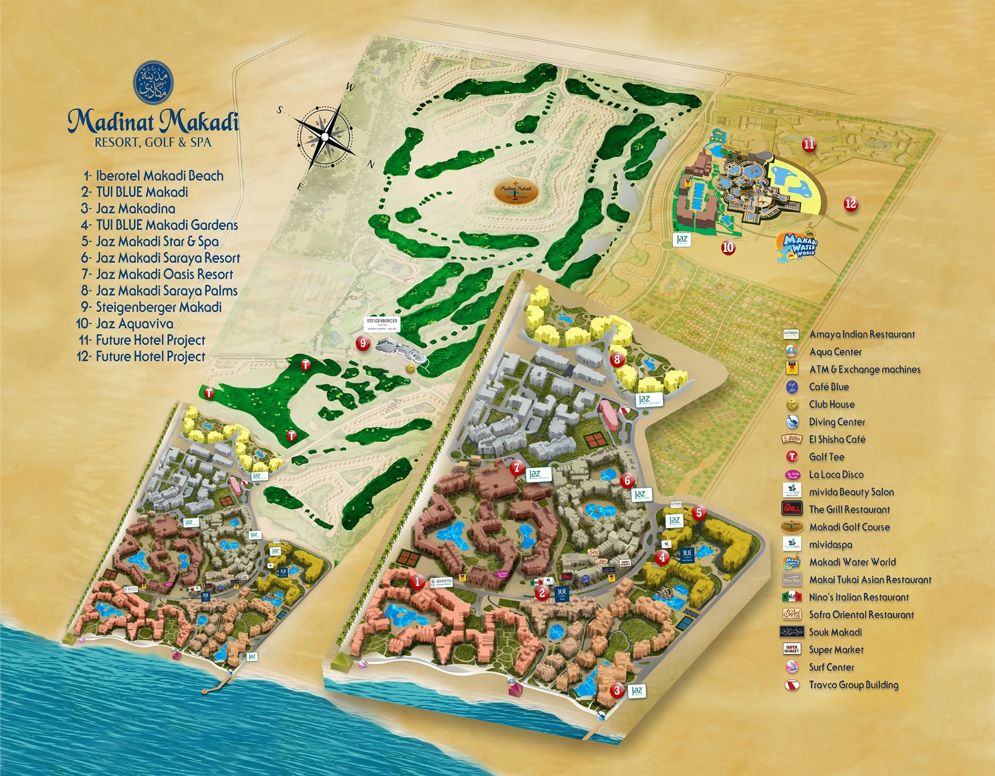
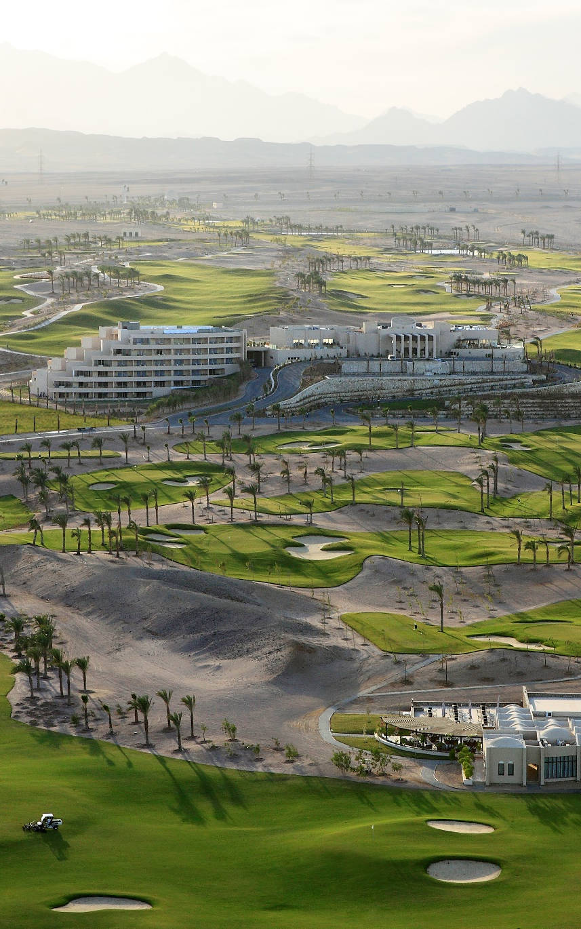

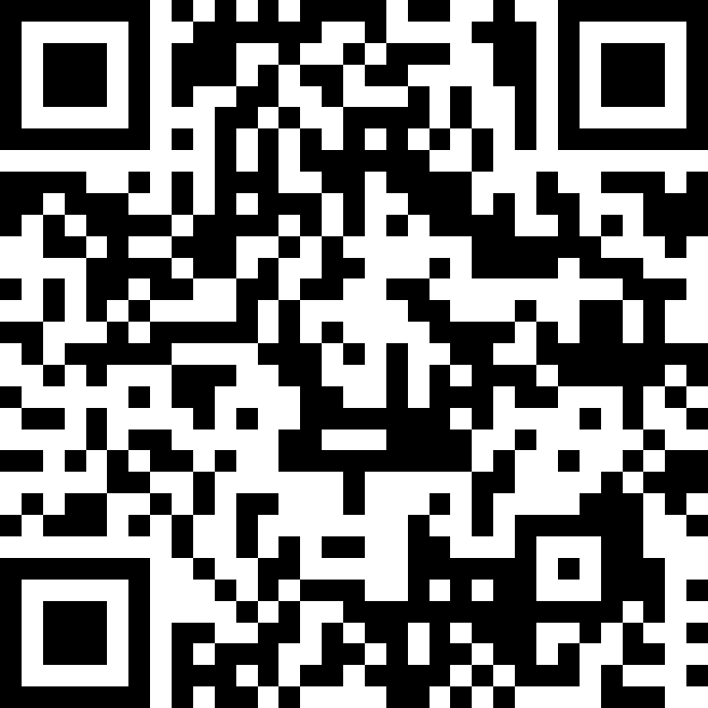
WELCOME TO
STEIGENBERGER MAKADI
Please scan the QR code for hotel in-stay survey

