Slide 1
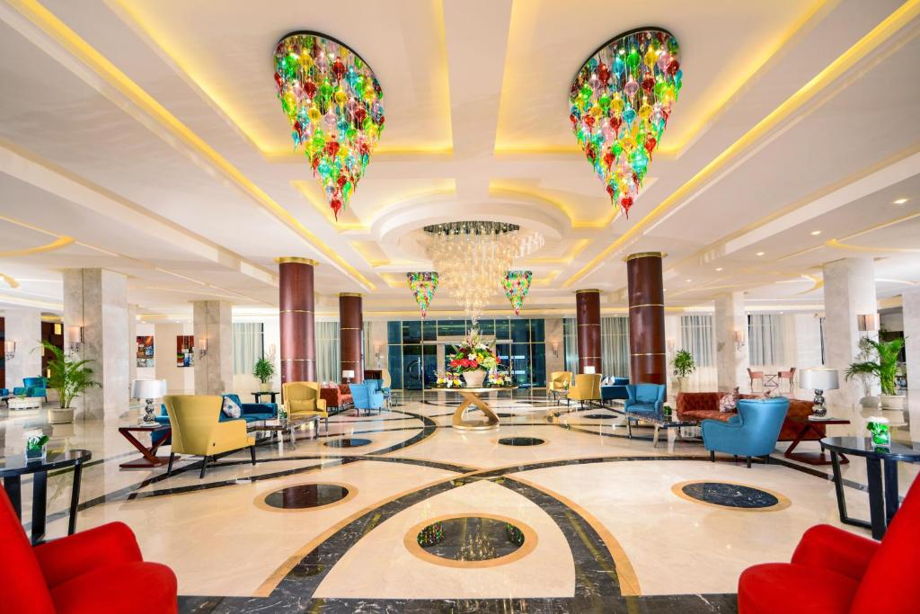
Beverages
Meals
Columbus Café 24/7
All Kinds of Drinks
Lobby Bar, from 10:00 till 00:00
Sports Bar, from 18:00 till 00:00
Beach Bar, from 10:00 till 23:00
Olympus Bar, from 10:00 till 18:00
Main Pool Bar, from 10:00 till 17:00
Terrace Bar, from 18:00 till 23:00
Relax Pool Bar, from 10:00 till 22:00
Aqua Park Bar, from 10:00 till 17:00
(Soft Drink Only)
Irish Pub, from 22:00 till 00:00
Ice Cream
Olympus Bar, from 12:00 till 16:00
Columbus Bar, from 15:00 till 17:00
Breakfast
Mediterranean Restaurant, from 07:00 till 10:00
German Restaurant- Zum Kaiser from 07:00 till 10:00
Asian Restaurant, L‘Asiatique from 07:00 till 10:00
Oriental Restaurant, Tagine from 07:00 till 10:00
Late Breakfast
Oriental Restaurant, Tagine from 10:00 till 11:00
Snacks
Beach Restaurant, Club MC from 12:00 till 17:00
Lunch
Mediterranean Restaurant, from 12:30 till 14:30
German Restaurant- Zum Kaiser from 12:30 till 14:30
Asian Restaurant, L‘Asiatique from 12:30 till 14:30
Oriental Restaurant, Tagine from 12:30 till 14:30
Dinner
Mediterranean Restaurant, from 18:30 till 21:00
German Restaurant- Zum Kaiser from 18:30 till 21:00
Asian Restaurant, L‘Asiatique from 18:30 till 21:00
Oriental Restaurant, Tagine from 18:30 till 21:00
Fish Restaurant, Culina from 18:30 till 21:00
Italian Restaurant, Soprano from 18:30 till 21:00
Late Dinner
Italian Restaurant, Soprano from 22:00 till 00:00
Cakes & Cookies
Columbus Café , from 15:00 till 17:00
ALL
INCLUSIVE FORMULA
NB:
Meal times and locations Can be subject to change due to weather conditions or unforeseen circumstances.
T: +20 653360000/ +20 653464817-18-19
F: +20 653360025/ +20 653464820
H: +20 15787
E: SALES@PICKALBATROS.COM
PICKALBATROS.COM

Slide 2
ACTIVITIES
IMPORTANT TO KNOW
Dress Code
The dress code around the hotel’s public areas and
restaurants are smart casual; gentlemen are kindly
requested to wear long trousers. Singlets, pool attire, and slippers are not permitted in the restaurant during dinnertime
Towel Cards
In case of loss, damage, or no return to the reception
upon checkout, US$ 15 will be charged to your bill
* services with extra charge
All the above information is subject to prior confirmation.
Club dance at 10:00
Stretching at 10:30
Darts at 11:00
Water ball at 11:15
Dance lesson at 11:30
Aqua Gym at 12:00
Water Volleyball at 15:15
Zumba Dance at 15:30
Darts at 15:45
Yoga at 16:00
Volleyball at 16:00
Kids Club daily from 10:00 to 13:00 & from 14:00 to 17:00
Check-Out Time
Check-out time is 12:00. For late check-out please
contact Reception for advice on the extra charge.
Laundry, Dry Cleaning, And Valet Services
Laundry bags and price lists are located on the armoire shelves; if your laundry is received by 09:00, it will be returned to you on the same day at 18:00
SPA & GYM
Gym Free Of Charge from 07:00 to 19:00.
Sauna / Steam / Hammam ( all Spa services ) are charged extra.
NB: Kindly note that the SPA is an Adults only zone.
Safe Box
We recommend placing all your valuables inside your room safe, usage instructions are displayed on the safe box door
Doctor
The clinic is open 24 hours, 7 days a week.
Doctors’ consultation at the clinic is available 24 hours.,
The concierge can help you obtain any prescriptions you may require
Foam Party at Beach Area - Every Friday at 15:00
White Party at Terrace Bar Stage Every Sunday at 20:00
NB:
Other Beach Activities: Beach football, Beach Tennis, Tennis table & Sunset Music.
ENTERTAINMENT
Club Dance daily at 20:00
Mini Disco at 20:30
Evening Show at The Amphitheater Stage daily at 21:00.

