Slide 1
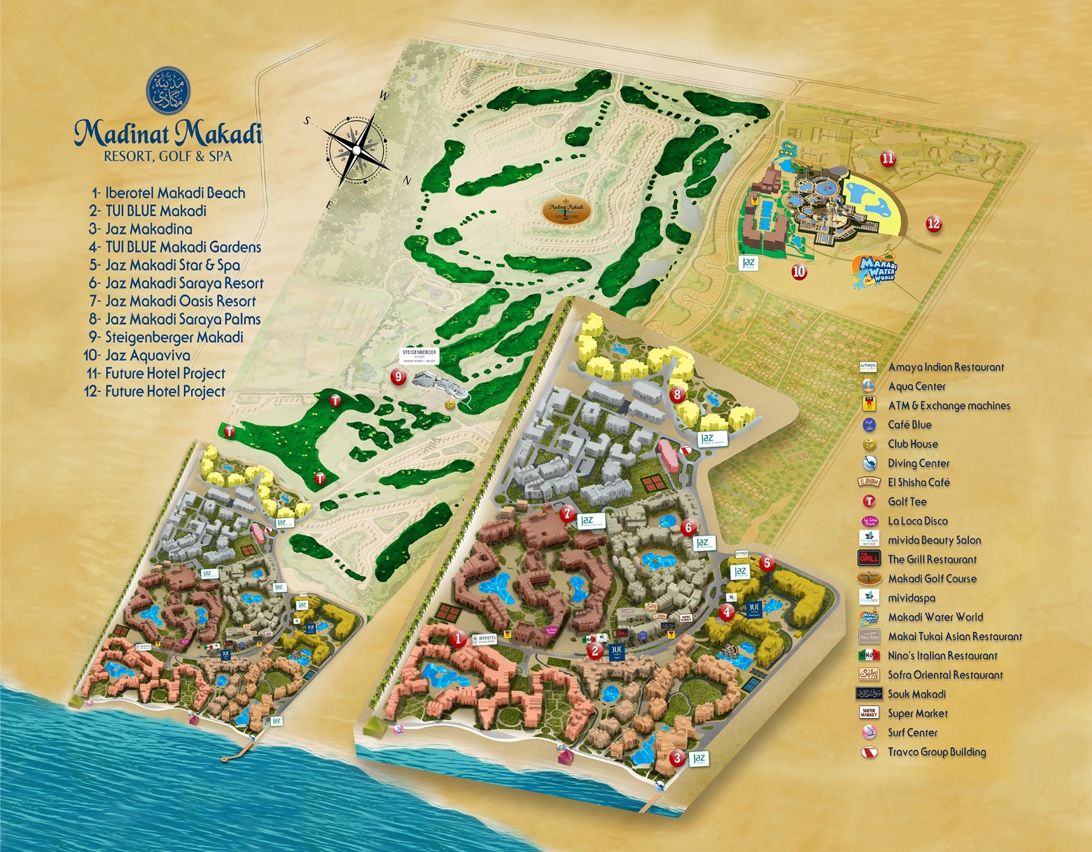

LIVE THE MAKADI MINDSET!
LIVE THE MAKADI MINDSET!
Jaz Makadina
Hotel Info - English
www.jazhotels.com 19380

Slide 2

ROOM & KEY CARD
When leaving the room the fridge remains active.
Tea and coffee making facilities are replenished daily
1.5L bottle of water per person on daily basis
Minibar: Please notice the minibar list in your room
Anti slip matt is available upon request .
SAFE
We kindly ask that all valuables are placed in the safe inside the wardrobe, as the hotel cannot accept any responsibility for the loss of these. Please leave the safe open on departure day.
TELEPHONE
Please contact reception by dialling 0. Available 24/7.
To make national or international calls, please contact our reception (2 Euro/Minute). To call another room, please dial 7 then the respective room number.
RECEPTION
Our 24 hour service will assist with all general questions, and provide relevant information such as directions, limo reservations, bedding, porter service etc.
Check-in 14:00 pm, check-out 12.00 pm. Late check-out is subject to availability and with extra charge.
INTERNET
Please activate your Wi-Fi and choose JHG network – enter your room number, first name and your email address in the appropriate fields.
Remember to turn off data roaming to avoid network charges from your operator.
POOL & BEACH AREA
You will find pool/beach towels inside your room, changed upon request on daily basis after 17:00, please leave the towels on the bathroom floor if you require a change. Outside of this time please ring reception.
“Do not disturb” sign is available with beach boys upon request.
The reservation of sunbeds is not permitted, and staff is authorised to remove items from sun loungers after extended periods of non-occupancy.
LAUNDRY
There is a laundry bag in the wardrobe, please fill out the laundry list with your items and the prices can be found in the laundry list.
RESTAURANTS & BARS
Al Masry Main Restaurant
Breakfast 07:00-10:00
Lunch 12:30-14:30
Dinner 18:30-21:30
Al Obba Pool Bar
Soft Drinks 09:00-00:00
Local alcoholic drinks and Cocktails 10:00 - 00:00
Ice Cream 10:00-17:00
Aqua Bar & Restaurant
Drinks Service 10:00-18:00
Snacks and a la carte lunch 12:30-16:00
Ice Cream 12:30-16:00
Al Sakkala
Late Breakfast 10:30-11:30
Snacks 12:00-17:00
Tea Time 16:00-17:00
Al Sultan Lobby Bar
Drinks 19:00-00:00
Our “All Inclusive” formula includes soft drinks, mineral water from dispensers, local beer and wine; all local drinks are served in glasses, not bottles, also including local cocktails. Imported alcoholic beverages for an additional fee.
Dress Code:
For dinner gentlemen are required to wear casual long trousers or smart shorts, ladies to dress modestly.
A LA CARTE RESTAURANTS
1 complimentary dinner per stay in one of the following a la carte restaurants: Nino’s, Amaya, Makai Tukai, Sofra, Beach Restaurant, The Grill or Aqua Restaurant.
Restaurants are located within the heart of Madinat Makadi. Please use the touch screen in the lobby to make your reservations.
Allergies and dietary requirements – please notify Restaurant Manager / Chef.
ENVIRONMENTAL AWARENESS
We are extremely concerned of our environment and as such make great efforts to support in all spheres wherever possible. For more information please refer to our environmental boards and TV information channel No.1.
SERVICES
Free of Charge
Upon request 1 day in advance book via reception:
  Wake up call
  Lunch/Breakfast box
  Tennis court (Floodlight 10 Euros/h)
Billiard 19:00-00:00
Table tennis/Table Soccer
Gym 07:00-19:00
Outdoor Jacuzzi 11:00-13:00 /15:00 till Sunset
ATMs are located in Souk Makadi, beside La Loca and in Jaz Aquaviva hotel
Sport & Entertainment
Various daytime activities 10:00-12:30 and 15:00-17:00
Daily evening show acts and live performances
Please refer to info boards for a full breakdown.
Jazy Kids Club
Our Jazy Kids Club open 10:00-12:30 and 15:00-17:00 for children from 4 to 12 y.o. Kids Disco at 20:00 at the Lobby Terrace.
Extra Charge
Minibar: Please notice the minibar list in your room
Laundry
Limousine service
El Shisha Corner ( from 12:00 – 00:00 )
Doctor(10:00-13:00 and 18:00-20:00) and Pharmacy
Makadi Water World Aqua park (Please contact the reception for free voucher)
Mividaspa
Diving center, surf center and water sports
Golf : A superb 18 hole championship golf course, a fun 9 hole par 3 course, plus excellent training facilities .
TAKE CARE
Avoid direct sunlight especially between 11:00-15:00. Temperatures can reach 45+, which might cause burns and severe dehydration.
Drink water continuously throughout the day. Water is provided in all hotel bars. Dehydration causes upset stomach, dizziness, nausea and headaches.
Always use sunscreen with sunblock to avoid sunburns. Wear a headgear when explored to the sun.
Avoid sudden changes in temperature (from warm to cold and vice versa). Give your body a few minutes to get used to the new temperature. Sudden temperature changes can cause health issues, please do not make your air conditioning in the room colder than 25 degrees.
Please note that due to fire regulations, smoking of hookahs / shisha in the room is not allowed.
The use of third-party providers outside the hotel (e.g. shops, limousines, etc.) is at your own responsibility.

