Slide 1
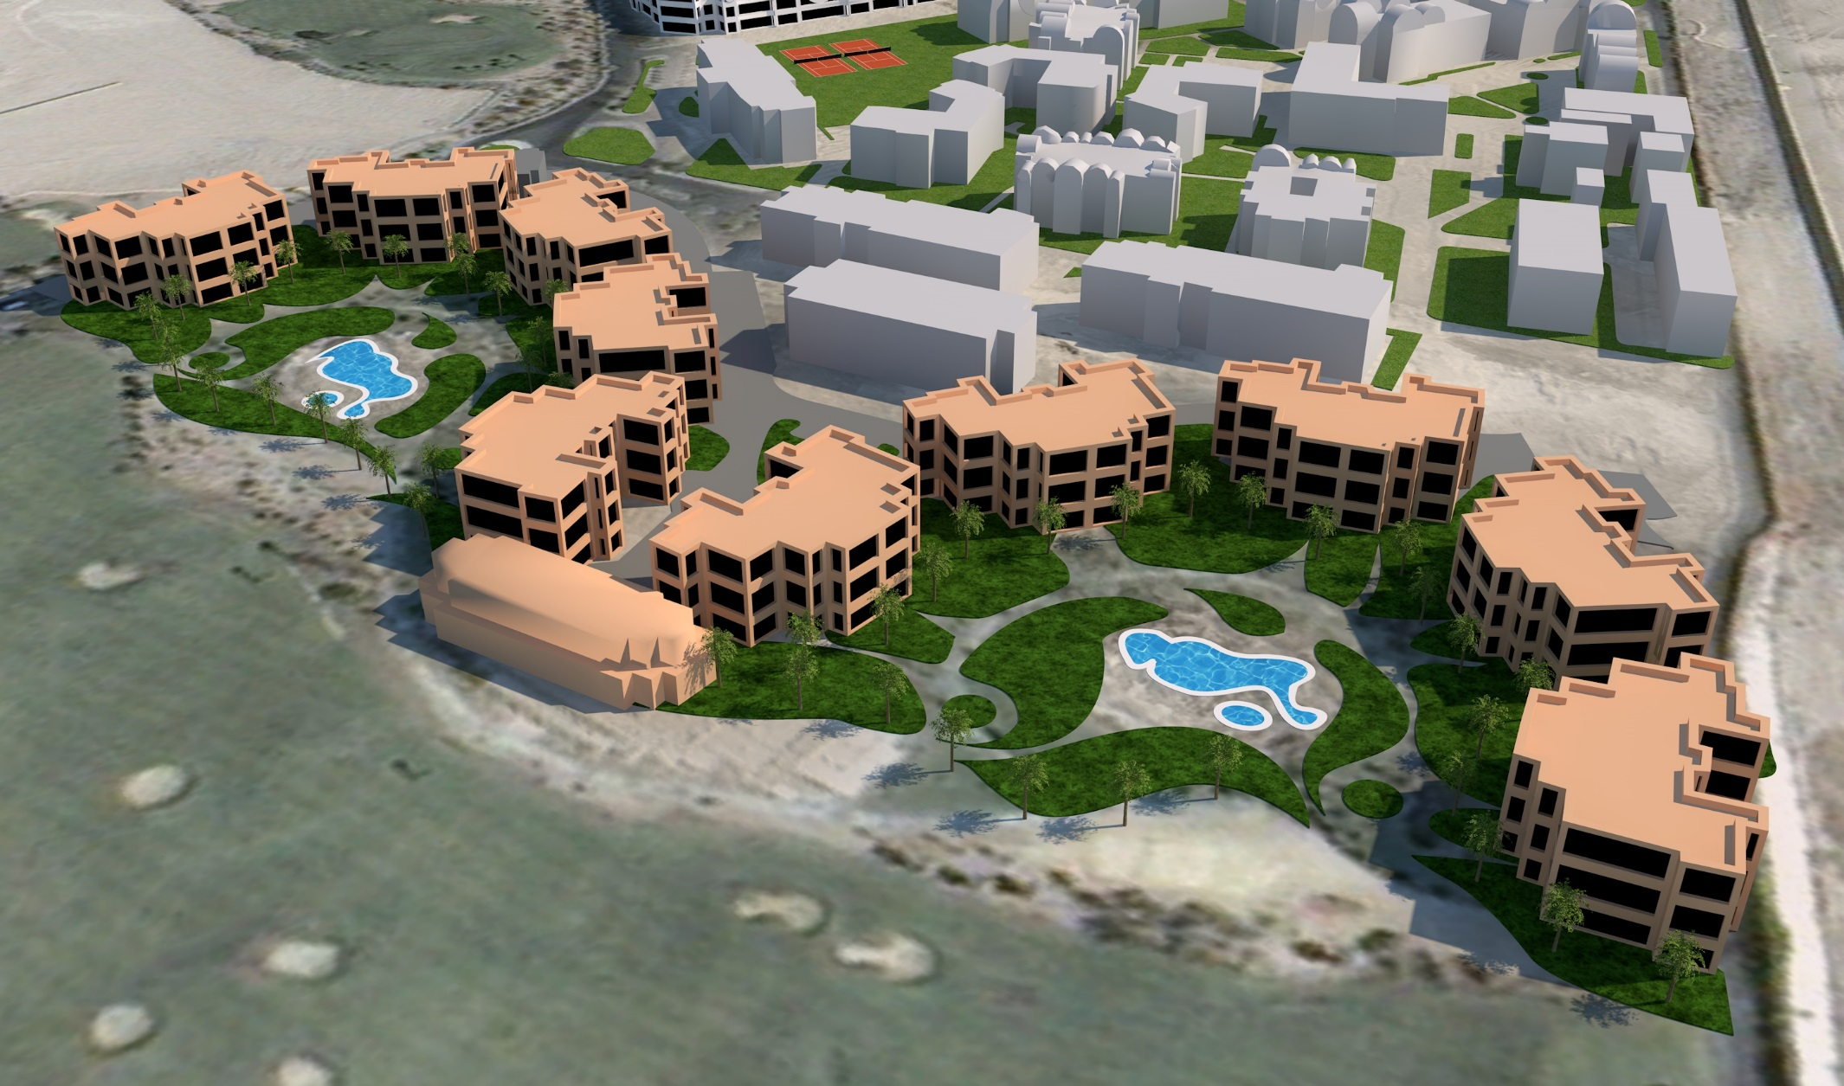
B2
1201-1224
1
B1
1101-1124
B3
1301-1324
B4
1401-1424
3
2
B7
1701-1724
B8
1801-1824
B5
1501-1522
9
B6
1601-1624
B9
1901-1922
5
8
1- Lobby Reception
2- Relaxing swimming Pool
3- Coco Pool Bar
4- Shams main Restaurant ground floor
5- Manzar Luong Bar 2nd floor
6- Al gezira Snacks Bar
7-Active swimming Pool
8- Coco Pool Bar
9- Kids Play ground
4
6
7
B10
2001-2022

