Slide 1
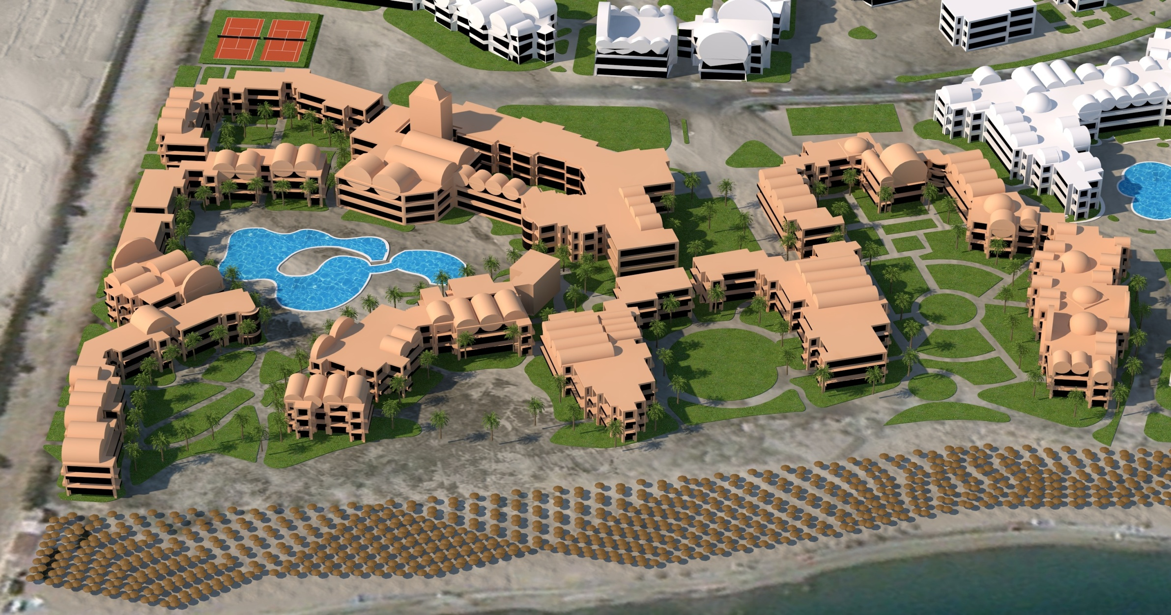
1
C
A
8
2
7
B
9
3
6
4
5
D
E
Numbers 1 – 9 → numbers of the groups
A → Mainrestaurant El Sayadeia
B → Poolrestaurant Terrasina
C → Tower & Oriental Restaurant Arabesque
D → Beachrestaurant
E → Beach of Iberotel Makadi Beach (beige/white umbrella)

